Slide 1

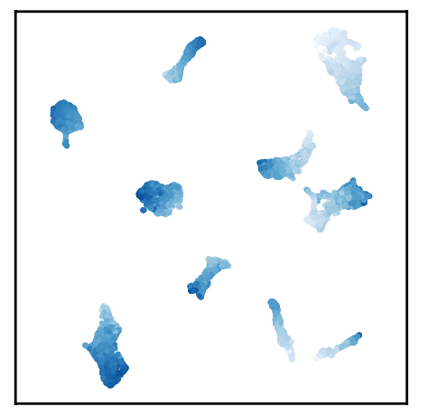

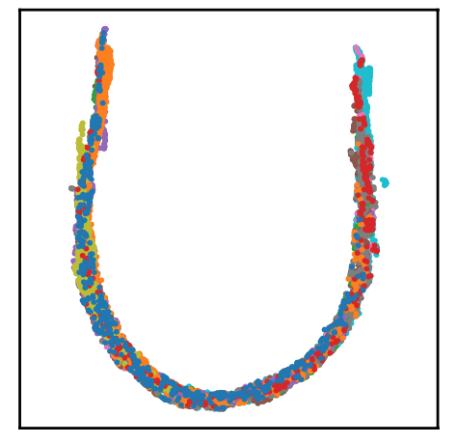

CS F425 - Deep Learning
Course Project, Group - 3
[Re] Rank-n-Contrast (NeurIPS’23 Spotlight)
Karan Bania (2021A7PS2582G) Tejas Agrawal (2021A3PS2789G) Rishav Mukherji (2020AAPS0330G) Jinam Keniya (2021A7PS1622G) Arnav Goyal (2021A7PS2596G)
Copyright for images - K. Zha, et. al.
Notes:
Hello everyone, today we are going to present implementation and reproduction of results from the Rank-n-Contrast paper presented in the NeurIPS’23 Spotlight. To recap, Rank-n-Contrast is a newly proposed regression loss.

Slide 2
Outline –
Reproduction of original results on AgeDB,
(Novel/Extra) Trying the loss on a Graph Regression task.
Notes:
We have tried to 1. Reproduce the results on the AgeDB dataset as in the paper and 2. have attempted novel task of using RnC loss on a Graph Regression Task on the ESOL dataset.

Slide 3
Part I. Reproduction of original results on AgeDB,
Dataset Used - AgeDB
Why AgeDB? Relatively smaller dataset for easier training
~16k celebrity face images and age values
~75:12.5:12.5 train:val:test split
Augmentation: RandomResizedCrop, RandomHorizontalFlip, RandomGrayscale, ColorJitter.
Obtained from here (i.bug UK)
Notes:
While the paper has used many datasets such as TUAB. SkyFinder, we mainly focus on the AgeDB as it is the smallest dataset amongst the ones they have used. This will result in easier training and comparison of results. It has 16k celebrity face images and we have used the same dataset split used in the paper which is approx. 75 : 12.5 : 12.5 for train, validation and test. For data augmentation techniques, we have used crop,flip,color and grayscale.

Slide 4
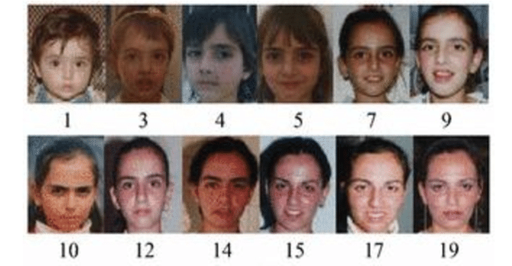
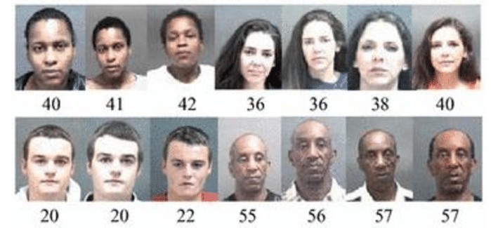
Part I. Reproduction of original results on AgeDB,
A few examples,
Reference : "AgeB: the first manually collected, in-the-wild age database"
Notes:
These are some sample examples from the AgeDB dataset wherein it involves age prediction from a given image.

Slide 5
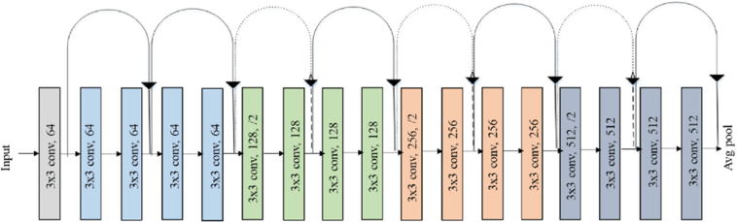
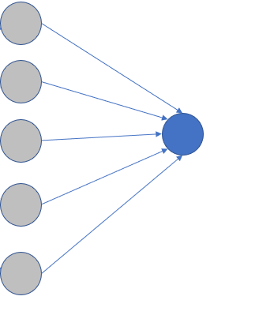
Model Definition
ResNet-18
Linear layer
Encoder
Regressor
Losses used to train encoder
L1, RnC
Losses used to train regressor
L1, L2, Huber
Notes:
Now moving on to the model used, we have used ResNet-18 as the encoder block to obtain feature representations which are then fed into a simple linear layer regressor. For encoder, we have used L1 loss as the base loss to compare with RnC loss, where as for regressor we have used L1,L2 and Huber losses for comparison. Now Jinam will talk about the experiments.

Slide 6
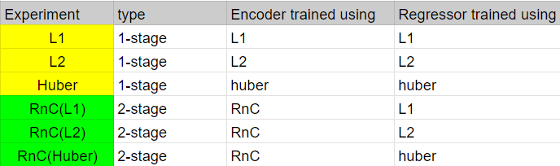
Experiments
Notes:
We have conducted these comparative experiments highlighting effectiveness of different loss functions: L1, L2, and Huber.
So for the first three experiments, we train the model in a single stage, training the encoder and the regressor together in an end-to-end manner using a loss function.
For next 3 experiments, we train the model in two stages, where the first stage required training only the encoder using the RnC mechanism using a certain feature similarity criterion. Then for the 2nd stage, the trained encoder is used for the training a regressor layer on top to match the output labels.

Slide 7
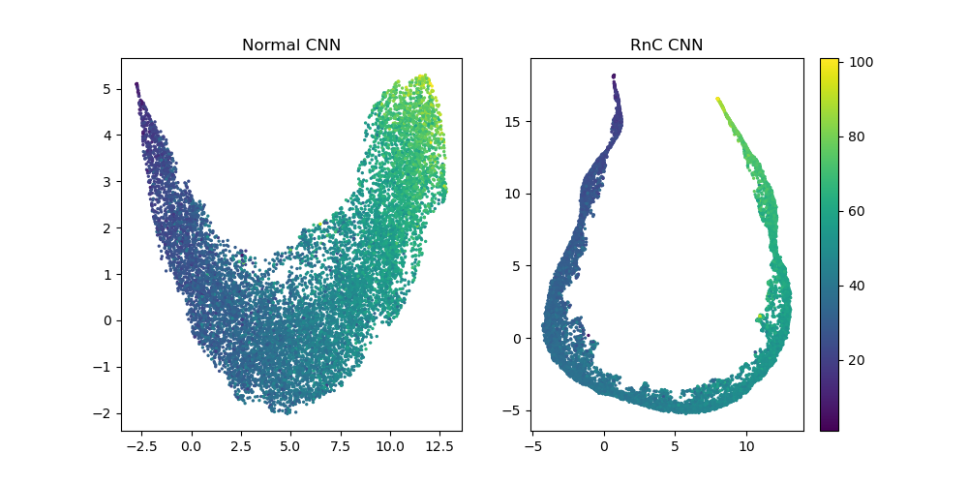
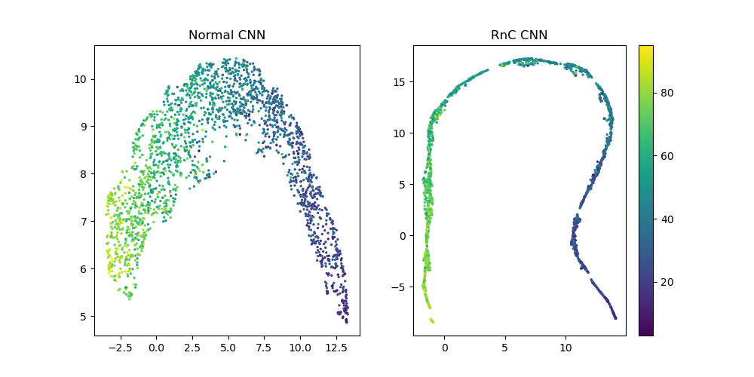
Encoder representation Visualisation
Train
Test
Notes:
These graphs are plotted to help visualize and highlight the continuity in the encoder’s representation. All the data is passed from our encoder to produce some representation space, that is passed through a dimensionality reduction algorithm, UMAP. We can see that an RnC trained encoder has a more continuous curve and gives a much more smoother transition across the label values, meanwhile in a vanilla encoder the graph is a bit distorted and with uneven transition.

Slide 8
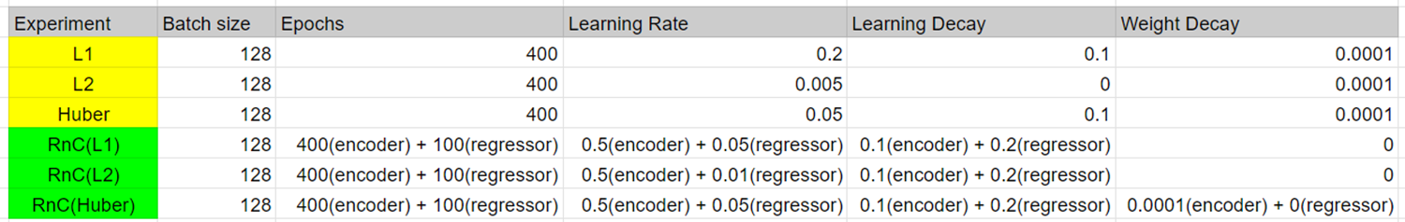
Hyperparams
Notes:
We first tried with the hyperparameters mentioned in the paper and then tried varying it slightly leading to these combinations.
The paper used the batch size of 256 for their experiments, but due to the computational constraints we had to use the reduced batch size of 128.
L2 was suffering from exploding gradients with NaN loss and thus we had to use a much smaller LR so it can converge properly.
This might explain the relatively worse replication of L2 and RnC(L2) compared to the other experiments. Ideally with more compute, we could’ve used K-folds CV to get more optimal hyperparameters.

Slide 9
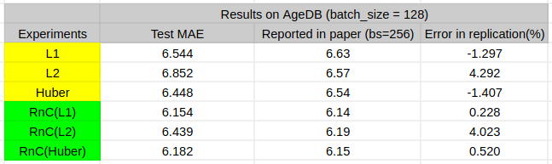
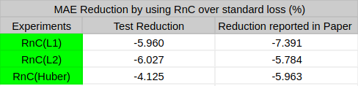
Reproduction of original results on AgeDB
Notes:
From the first table we can see that we are able to reproduce all the six experiments within about ~4% of results reported in the paper
Also, second table shows that the model having an encoder trained on RnC and a regressor head trained on some loss function, outperforms the model trained directly on the corresponding loss function, by around ~5%.

Slide 10
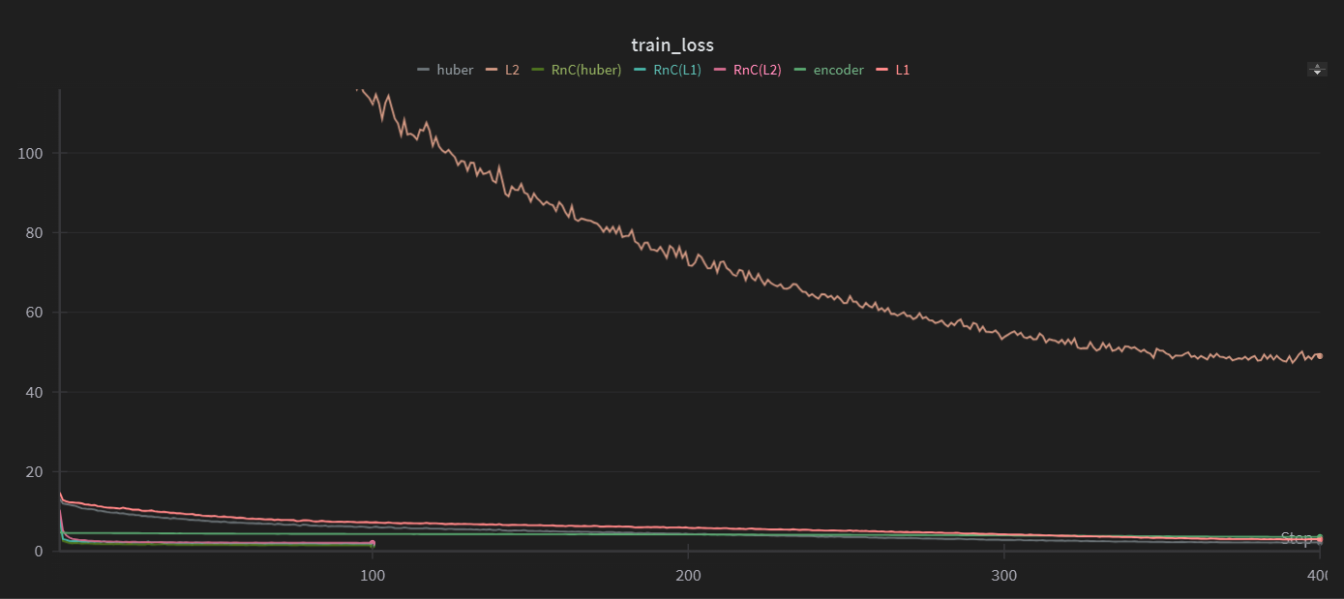
Train Loss

Slide 11
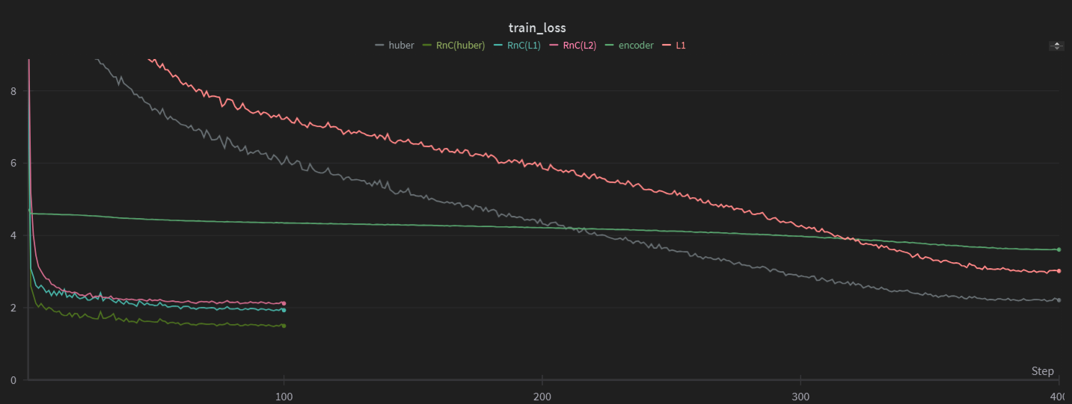
Train Loss (L2 plot removed)

Slide 12
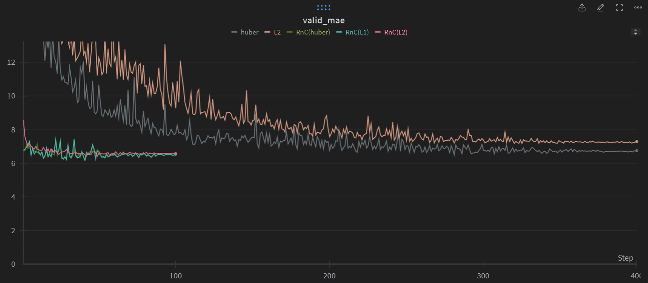
Validation Loss

Slide 13
Part II. (Novel/Extra) Trying the loss on a Graph Regression task,
The Dataset,
ESOL (Estimated SOLubility),
1128 molecules and their solubility values,
Why ESOL? Small enough to experiment quickly, Relevant enough to be challenging.
80:10:10 train:val:test split.
Notes:
As part 2, we will be trying the loss on a graph regression task. We are using the ESOL dataset, it has 1128 molecules and their solubilities. We decided to pick this dataset because it is small enough for us to demonstrate novelty and is relevant in Geometric Learning Circles. We have used the standard split of 80:10:10, which is the standard split used with this dataset.

Slide 14
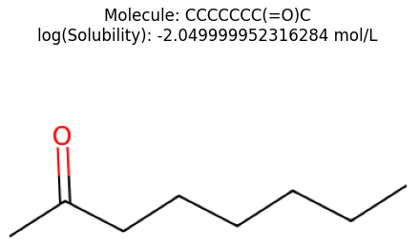
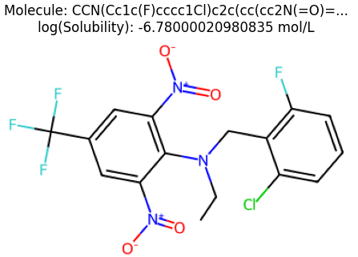
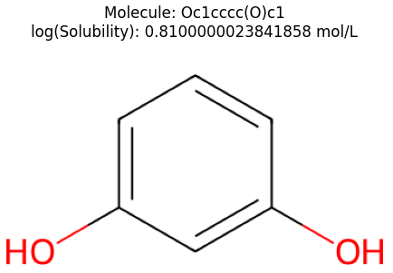
Part II. (Novel/Extra) Trying the loss on a Graph Regression task,
A few examples, (plotted using RDkit)
Notes:
These are a few examples from the dataset.

Slide 15
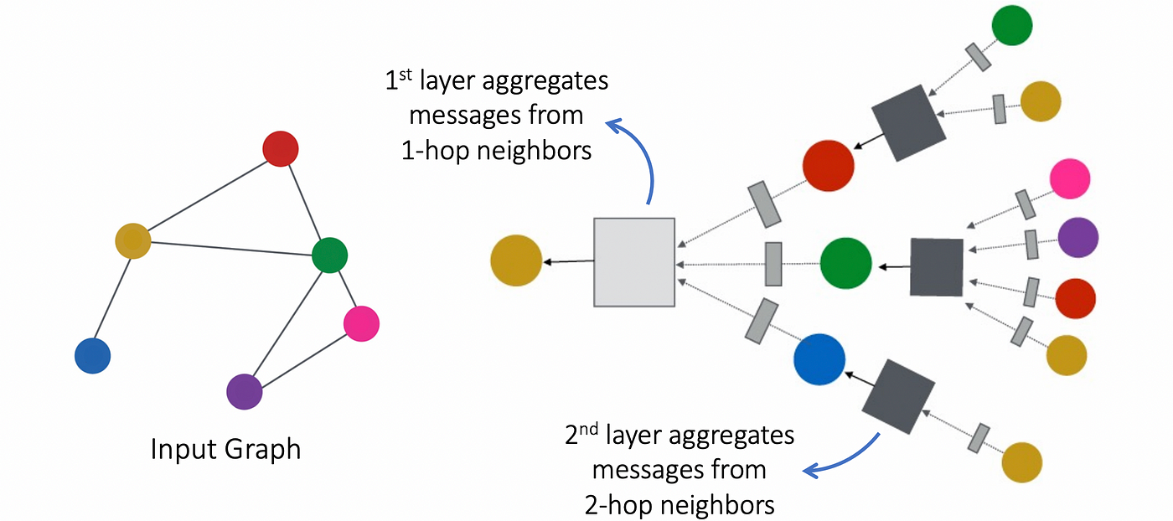
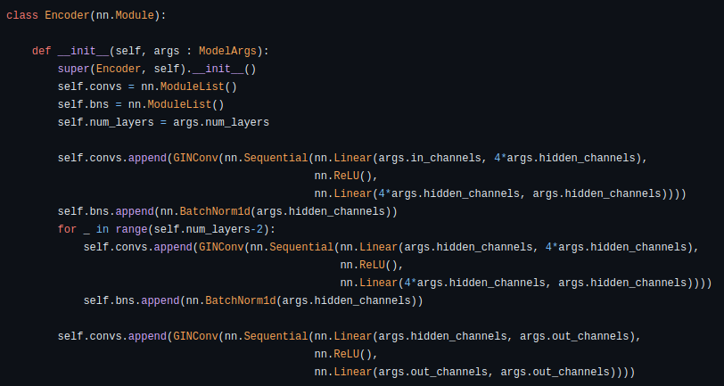
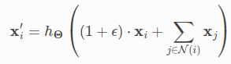
Part II. (Novel/Extra) Trying the loss on a Graph Regression task,
Model Definition
Notes:
About the model structure, this is the overall structure of our encoder. The diagram on the left is a normal GNN, the layer that we are using can be thought of this diagram + a self-connection everywhere; as seen in the equation. The default hyper-parameters are - in_channels = 9, out_channels = 100, hidden_channels = 64, num_layers = 5, no dropout.

Slide 16
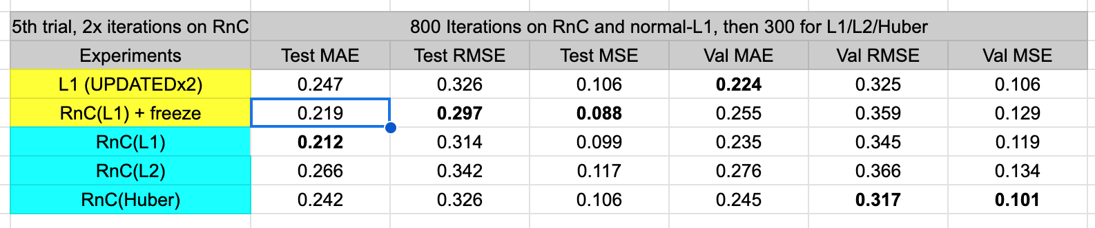
Part II. (Novel/Extra) Trying the loss on a Graph Regression task,
First, results and then the approach. [NUMBERS]
Notice, all RnC based methods beat normal-L1, and the difference is significant.
Notes:
So basically, our final experiment shows that RnC beats L1 under a similar setting to the paper for all possible loss combinations with a significant difference. As you can notice from the test MAE, RMSE and MSE.

Slide 17
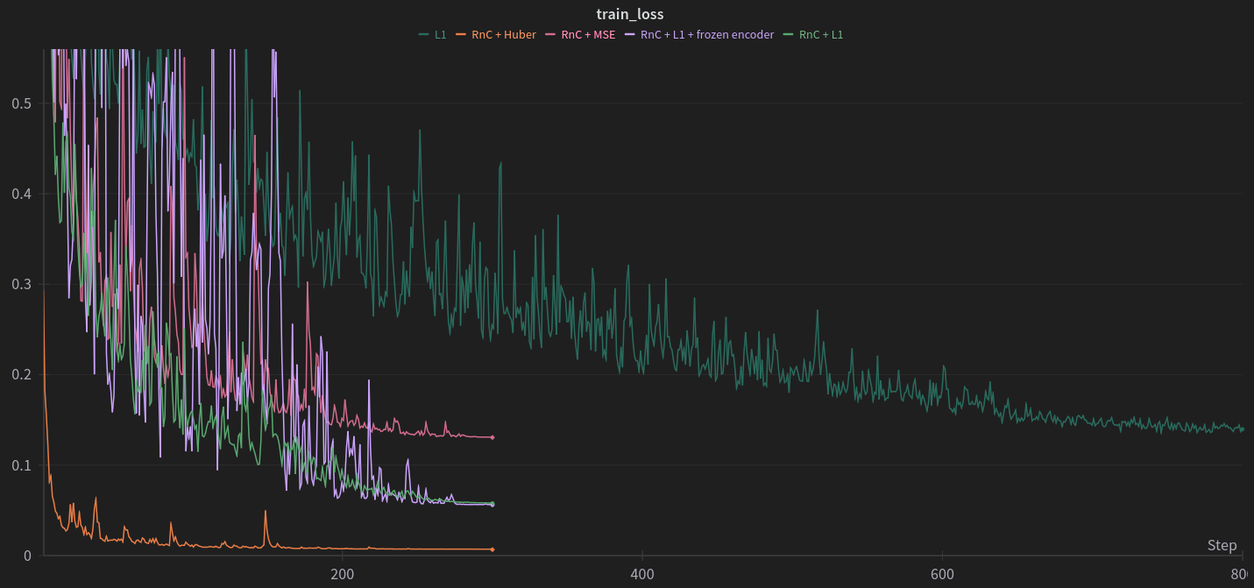
Part II. (Novel/Extra) Trying the loss on a Graph Regression task,
First, results and then the approach. [PLOTS]
Notes:
Now moving on to the loss plots. However, Note that, this isn’t a good plot to compare models, but is added here to show that the training has stabilised. This is not correct because different runs have used different loss functions and we cannot compare the values of different loss functions. Although we can notice that the RnC(L1) models (purple + light green) do achieve a lower train loss than the normal-L1 method.

Slide 18
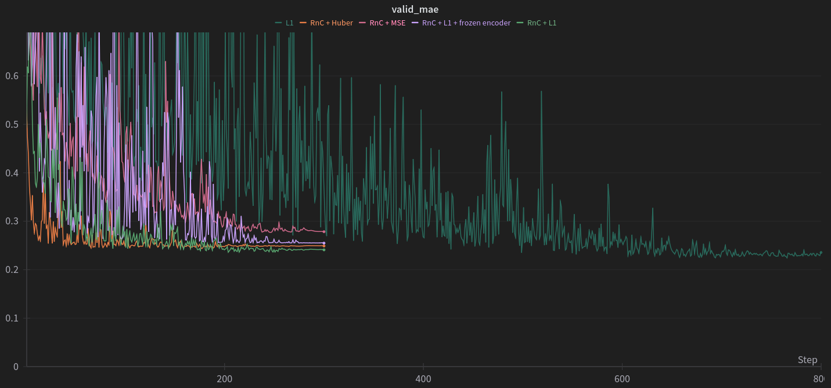
Notes:
This is a proper graph of the MAE. Here, RnC(L1) beats L1, but in general it is tough to beat normal-L1!

Slide 19
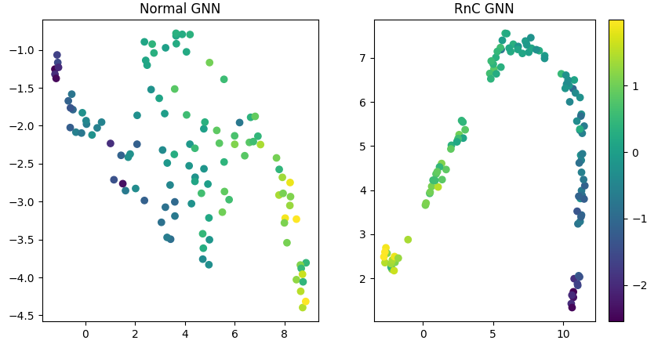
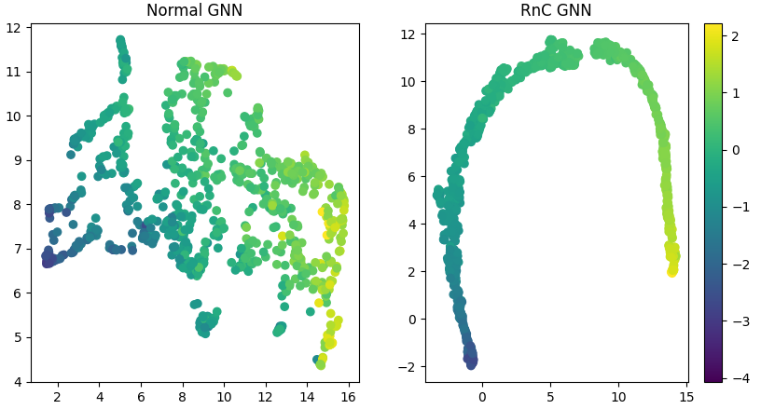
Part II. (Novel/Extra) Trying the loss on a Graph Regression task,
First, results and then the approach. [REP-SPACE]
Test
Train
Notes:
These are UMAP plots of the representation spaces learned by these models, UMAP is a dimensionality reduction similar to T-SNE used by the paper. The model clearly learns a representation space analogous to the paper, which is very linear compared to the normal-L1 which is learning random stuff.

Slide 20
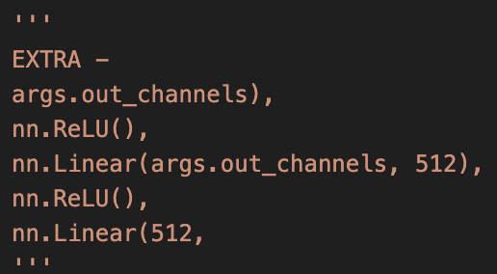
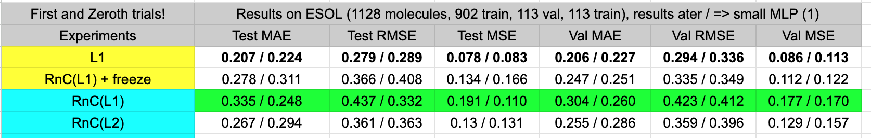
Part II. (Novel/Extra) Trying the loss on a Graph Regression task,
Approach / Interesting findings,
A bigger MLP, doesn’t work!
Notes:
Now moving onto the approach. So our couple of initial runs did not have good performance on TEST or VALID. What happened is that we were using a bigger MLP instead of a single layer, from this experiment, we concluded that a bigger MLP can effectively distort the RnC learned space and so the performance isn’t good. Notice how using a smaller MLP is beneficial for RnC!

Slide 21
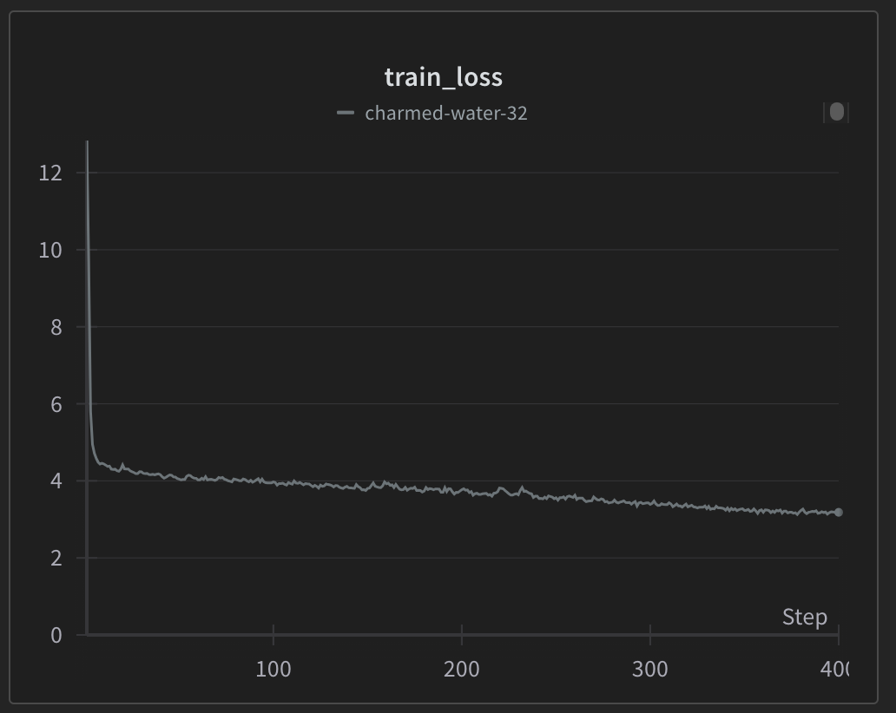
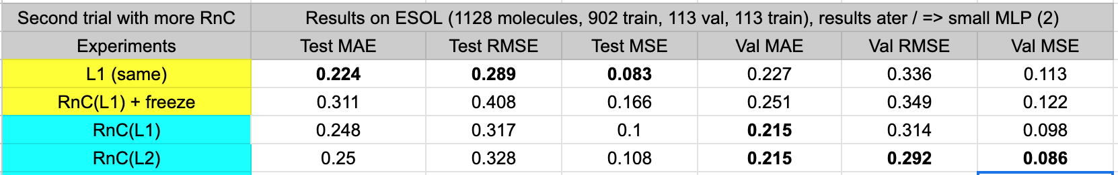
Part II. (Novel/Extra) Trying the loss on a Graph Regression task,
Approach / Interesting findings,
Bigger LR for RnC.
Notes:
The left plot is from the RnC run from the first runs, you can see that the RnC loss is continuously decreasing, and so we concluded that RnC needs more time / more LR. In view of our compute constraints we increased the LR, as you can see, we beat the normal-L1 on Validation Set!

Slide 22
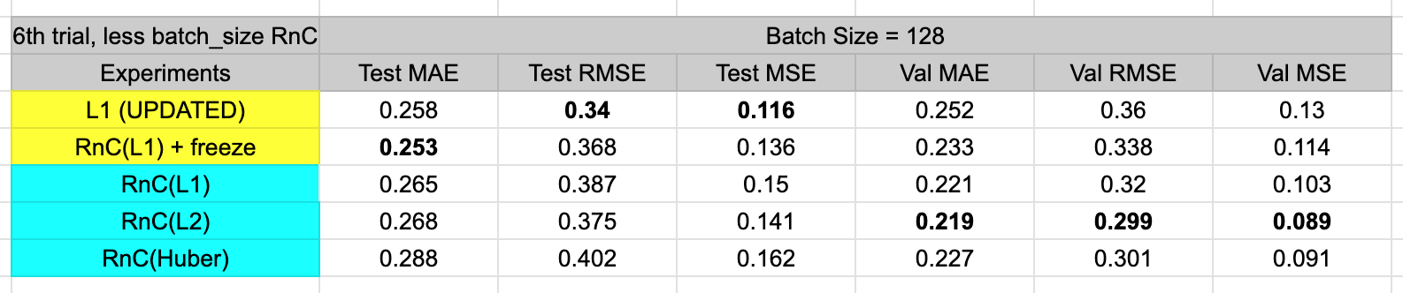
Part II. (Novel/Extra) Trying the loss on a Graph Regression task,
Approach / Interesting findings,
Expose normal-L1 and RnC to same information.
Notes:
Although I beat the normal-L1 on validation set, uptill now the batch sizes for RnC and L1 runs were different. So even if they had the same epochs, there could have been differences in learning. So we normalized this gap by setting the same LR and batch-size. Although this beat normal-L1 on test in one case, the performance on the validation set decreased and so we did our final run with more epochs, higher lr and a bigger batch_size than what is used for normal-L1.

Slide 23
Part II. (Novel/Extra) Trying the loss on a Graph Regression task,
Further experiments?
Test till what epoch does RnC performance really increase? Because, loss was decreasing.
Try to see what hyperparams work for a bigger MLP?
More regression datasets?
Notes:
These are some questions we would really like to explore.

Slide 24
Thank you! Questions?
[link to our public repository with all the code]
[link to google sheet with experimental results on the AgeDB dataset]
[link to google sheet with a (few) more experiments for the ESOL dataset]
[link to the w&b report with all runs on the AgeDB dataset]
[link to the w&b with all runs on the ESOL dataset]

